Slide 1
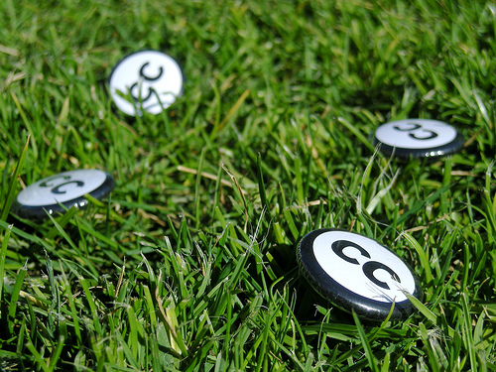



Creative Commons
Jessica Coates
Creative Commons Clinic
May 2008
Carpeted commons by Glutnix, http://www.flickr.com/photos/glutnix/2079709803/in/pool-ccswagcontest07 available under a Creative Commons Attribution 2.0 licence, http://creativecommons.org/licenses/by/2.0/deed.en
AUSTRALIA
part of the Creative Commons international initiative
CRICOS No. 00213J

Slide 2
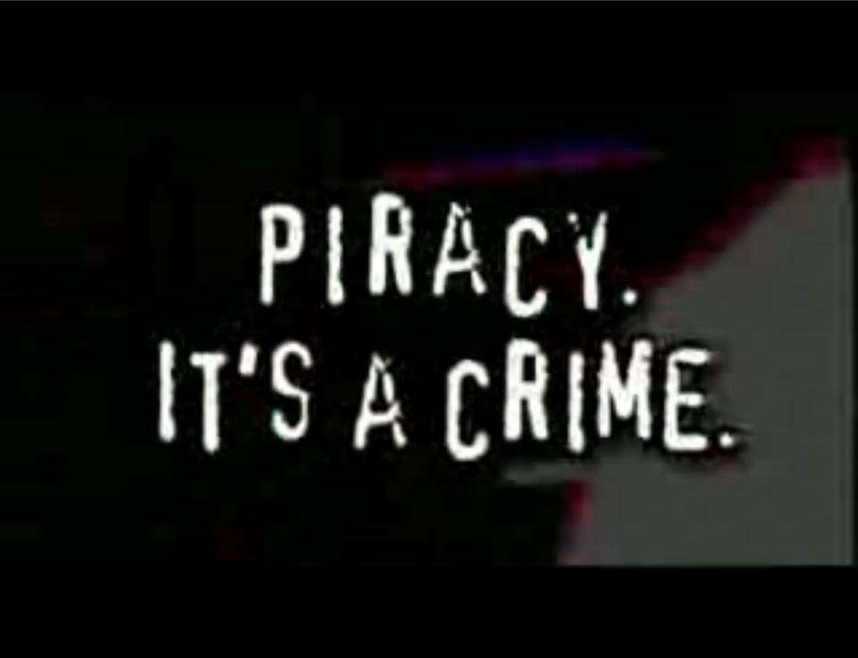

AUSTRALIA
part of the Creative Commons international initiative
CRICOS No. 00213J
Notes:
Standard copyright law says that you can’t reproduce or communicate creative material (eg movies, books, music etc) without the copyright owner’s permission, except in very limited circumstances
The problem with this in the digital era is that every use of material makes a reproduction. This includes just viewing
This means that, under the default copyright laws, printing out a webpage, emailing a picture to your friend, making a digital collage or remix work etc will all generally infringe copyright

Slide 3


Why have copyright?
by granting creators commercial publication rights you ensure that they will be remunerated, which gives incentive for them to create
traditionally, all reproductions = commercial publication
therefore, copyright prohibits all unauthorised reproductions
AUSTRALIA
part of the Creative Commons international initiative
CRICOS No. 00213J
Notes:
Standard copyright law says that you can’t reproduce or communicate creative material (eg movies, books, music etc) without the copyright owner’s permission, except in very limited circumstances
The problem with this in the digital era is that every use of material makes a reproduction. This includes just viewing
This means that, under the default copyright laws, printing out a webpage, emailing a picture to your friend, making a digital collage or remix work etc will all generally infringe copyright

Slide 4
What can you do without permission?
Email a news article to a friend?
Download a song onto your hard drive?
Post a picture/song/film onto your blog page?
Use a song in a podcast or in the soundtrack of a short film?
Create a remix or mash up out of video/music clips?
Record a cover song?
AUSTRALIA
part of the Creative Commons international initiative
CRICOS No. 00213J

Slide 5
What can you do without permission?
Email a news article to a friend?
Download a song onto your hard drive?
Post a picture/song/film onto your blog page?
Use a song in a podcast or in the soundtrack of a short film?
Create a remix or mash up out of video/music clips?
Record a cover song?
No
No
No
No
No
No
AUSTRALIA
part of the Creative Commons international initiative
CRICOS No. 00213J

Slide 6
Default copyright
Copyright is important. But in its current form it:
doesn’t reflect the behaviour of ordinary users
doesn’t reflect the wishes of many creators
makes it difficult to promote, collaborate or remix
prevents digital technologies from being used to their fullest
AUSTRALIA
part of the Creative Commons international initiative
CRICOS No. 00213J

Slide 7
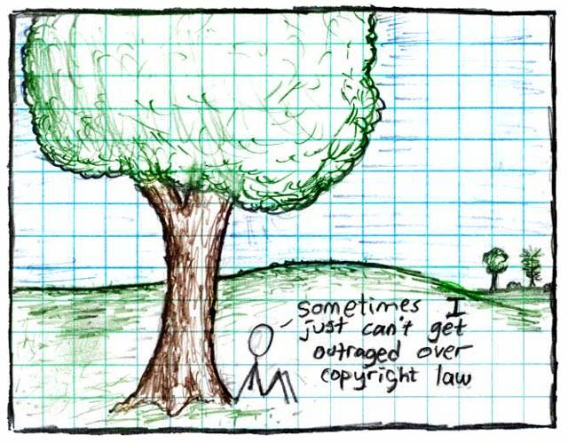
"Copyright", Randall Munroe, http://xkcd.org/14/, Creative Commons Attribution-NonCommercial 2.5 license
AUSTRALIA
part of the Creative Commons international initiative
CRICOS No. 00213J
Notes:
Some just say ignore copyright law – rip, mix, burn
This is ok if you’re an private user, or an obscure artist – can choose to take risk
But doesn’t work for schools, libraries, museums, charities, academics, short film makers entering into competitions, DJs releasing a commercial CD etc
Plus, the music labels and hollywood are suing people now – and in the UK they’re threatening to cut off people’s internet connections.

Slide 8

Aims to make creative material more useable by providing free licences that creators can use to give certain permissions in advance
AUSTRALIA
part of the Creative Commons international initiative
CRICOS No. 00213J
Notes:
Non-profit
Founded in 2001
These academics became concerned that the default copyright laws that applied in most countries were restricting creativity in the digital environment by preventing people from being able to access, remix and distribute copyright material online
Taking inspiration from the open source movement, they decided to develop a set of licences that creators could use to make their material more freely available without giving up their copyright
They wanted to replace the standard “all rights reserved” model with a new, more flexible, “some rights reserved”

Slide 9

CC is designed to…
provide standardised licences
that facilitate sharing
are flexible
are easy to use and understand (for people and machines) and
that apply in the same way anywhere in the world.
AUSTRALIA
part of the Creative Commons international initiative
CRICOS No. 00213J
Notes:
In writing the licences, the main goal was to ensure that the licences are:
Voluntary – contrary to some claims, CC isn’t anti-copyright. It just aims to provide options for those copyright owners who do want to make their material more freely available
Flexible – unlike other parts of the open access movement, CC licences are specifically designed to provide a range of options for licensors, so that they can choose exactly how they want their material to be used
Easy to understand – the academics designing the licences felt that one of the biggest problems with default copyright law is that its so hard for both copyright owners and users to understand. So the licences are specifically designed to be as simple as possible.
And, of course, freely available for everyone to use

Slide 10
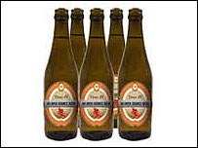
CC Myths
CC is not:
anti-copyright – just another rights management tool for creators
the public domain – just giving certain permission in advance
anti-commercial – can charge for first use, commercial uses, “premium” service, or embed advertising
right for every situation – entirely voluntary, and won’t be best solution for all creators
free as in speech,
not as in beer
AUSTRALIA
part of the Creative Commons international initiative
CRICOS No. 00213J
Notes:
Non-profit
Founded in 2001
These academics became concerned that the default copyright laws that applied in most countries were restricting creativity in the digital environment by preventing people from being able to access, remix and distribute copyright material online
For instances – most people know that it’s currently illegal under Australian law to record a television show to watch later – but did you also know that, in the absence of any licence, it’s also arguably illegal to print off a webpage for personal use, or to use a song in the background of a home video, or a student film
Even those people who want to make their material more freely available can’t do so without hiring lawyers
Taking inspiration from the open source movement, they decided to develop a set of licences that creators could use to make their material more freely available without giving up their copyright
They wanted to replace the standard “all rights reserved” model with a new, more flexible, “some rights reserved”

Slide 11




Licence Elements
      Attribution – attribute the author
      Noncommercial – no commercial use
      No Derivative Works – no remixing
      ShareAlike – remix only if you let others remix
AUSTRALIA
part of the Creative Commons international initiative
CRICOS No. 00213J
Notes:
The first CC licences were released in 2002
The central to each of the CC licences are the four licence elements – Attribution, noncommercial, no derivative and sharealike
These represent restrictions that copyright owners may want to put on how people can use their material.
As you can see, each of the elements has a symbol that can be used to ‘represent’ each of these elements
this makes the licences easier understand – in theory, once a person is familiar with the CC licences, they should be able to recognise what uses are allowed simply by looking at the symbols

Slide 12
Attribution
Attribution-ShareAlike
Attribution-Noncommercial
Attribution-Noncommercial-ShareAlike
Attribution-NoDerivatives
Attribution-Noncommercial-NoDerivatives
AUSTRALIA
part of the Creative Commons international initiative
CRICOS No. 00213J
Notes:
Users can mix and match these elements to set the conditions of use for their material
So, for example, an author may be happy to allow private uses of their work, but may want to limit how it can be used commercially.
They may also want people to remix their work, but only so long as that person attributes them and makes the new work available for others to remix
So they can choose the Attribution-noncommercial-sharealike licence

Slide 13
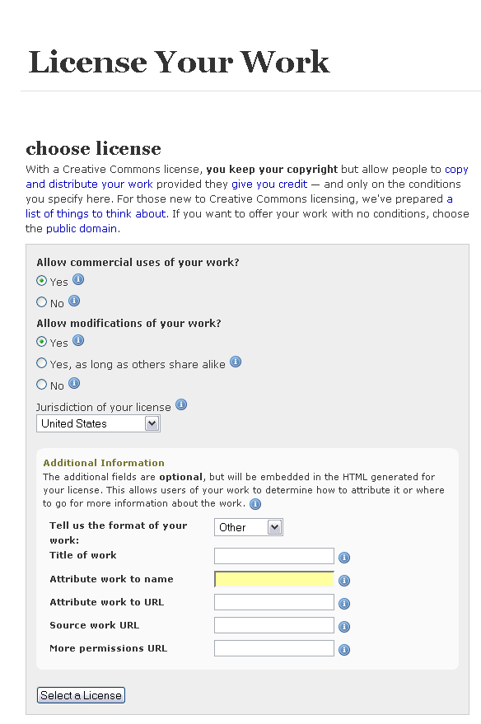
CC system
licence generator
AUSTRALIA
part of the Creative Commons international initiative
CRICOS No. 00213J
Notes:
CC also has a number of tailored licences, for example:
the Sampling Licences – allow portions of a work, but not the whole, to be remixed into new works, even commercially;
the Public Domain Dedication – lets creators revoke their copyright rights entirely, and donate their work to the public domain;

Slide 14
CC system
licence button
AUSTRALIA
part of the Creative Commons international initiative
CRICOS No. 00213J
Notes:
CC also has a number of tailored licences, for example:
the Sampling Licences – allow portions of a work, but not the whole, to be remixed into new works, even commercially;
the Public Domain Dedication – lets creators revoke their copyright rights entirely, and donate their work to the public domain;

Slide 15
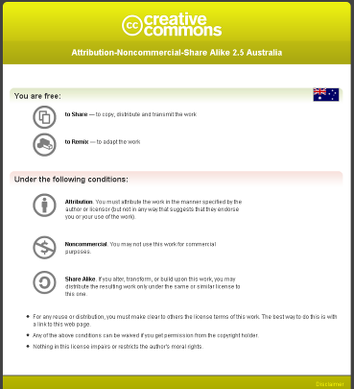
CC system
licence deed
AUSTRALIA
part of the Creative Commons international initiative
CRICOS No. 00213J
Notes:
CC also has a number of tailored licences, for example:
the Sampling Licences – allow portions of a work, but not the whole, to be remixed into new works, even commercially;
the Public Domain Dedication – lets creators revoke their copyright rights entirely, and donate their work to the public domain;

Slide 16
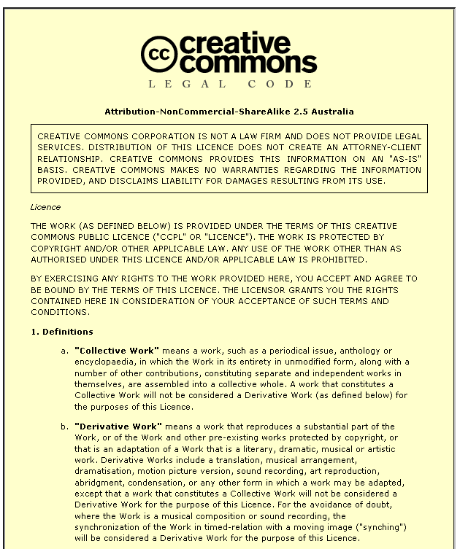
CC system
legal code
AUSTRALIA
part of the Creative Commons international initiative
CRICOS No. 00213J
Notes:
CC also has a number of tailored licences, for example:
the Sampling Licences – allow portions of a work, but not the whole, to be remixed into new works, even commercially;
the Public Domain Dedication – lets creators revoke their copyright rights entirely, and donate their work to the public domain;

Slide 17
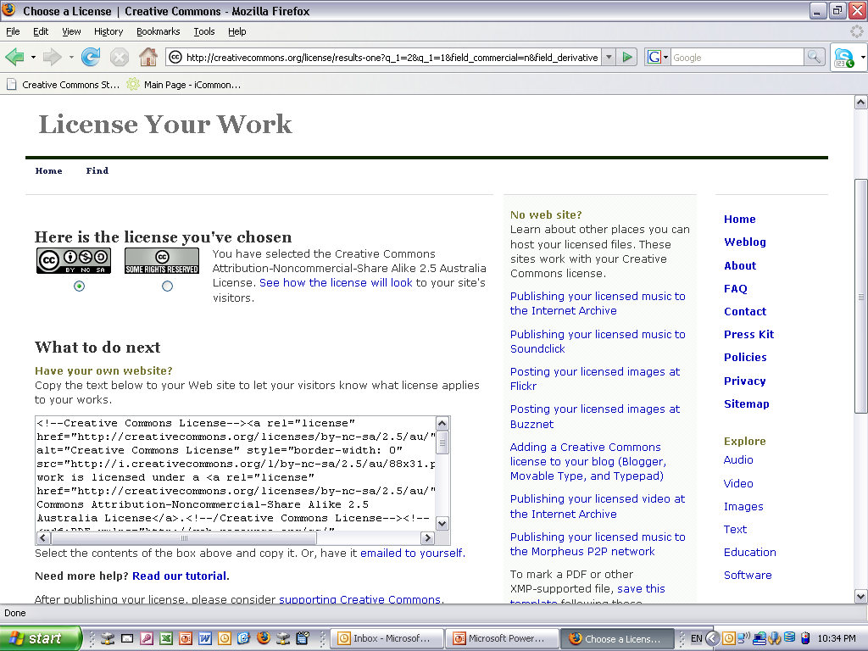
CC system
metadata
AUSTRALIA
part of the Creative Commons international initiative
CRICOS No. 00213J
Notes:
CC also has a number of tailored licences, for example:
the Sampling Licences – allow portions of a work, but not the whole, to be remixed into new works, even commercially;
the Public Domain Dedication – lets creators revoke their copyright rights entirely, and donate their work to the public domain;

Slide 18
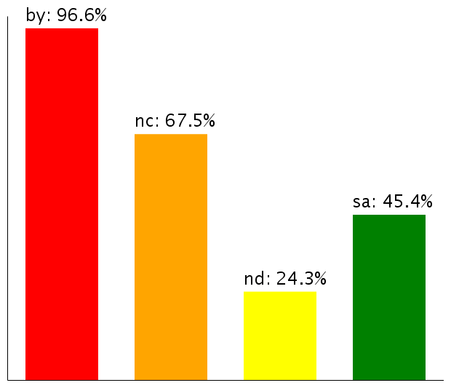
Licence Use
In the first year 1 million works, now 160 million
Over 80 million images on Flickr alone
Most have Noncommercial limitation
Moving towards more liberal licences
Use of licence elements – June 2006
AUSTRALIA
part of the Creative Commons international initiative
CRICOS No. 00213J
Notes:
So – looking at how the CC licences are being used
According to the latest statistics from the CC website, there are currently about 140million webpages that use a CC licence
As you can see, almost all of them contain the BY element – that’s because it was made compulsory for all the licences except the public domain licences after the first year, because pretty much everybody was using it anyway
The majority also, unsurprisingly, choose the non-commercial element
Interestingly, next most popular is ShareAlike, not noderivatives – this shows that there is still a strong focus on fostering creativity among CC community, and that, rather than trying to lock their material up, people are happy for it to be remixed, as long as the new work is also sharedEven more interesting is how these statistics are changing over time
Even more interestingly – if you look at how the licences is being used over time, people are gradually moving towards more liberal licences with less restrictions on them
This movement seems to indicate that as people become more familiar with the licences, they are more comfortable allowing greater use
This is supported by anecdotal evidence from CC users who, after initially publishing their material under restrictive licences that don’t allow derivatives, often ‘re-release’ their material to allow new works

Slide 19




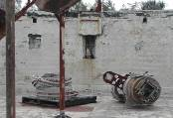

CC as a resource
Find legal material
Simplify copyright decisions
Clarify legal rights and responsibility
Reduce costs
Streamline processes
Access new/innovative material
AUSTRALIA
part of the Creative Commons international initiative
CRICOS No. 00213J
Notes:
In writing the licences, the main goal was to ensure that the licences are:
Voluntary – contrary to some claims, CC isn’t anti-copyright. It just aims to provide options for those copyright owners who do want to make their material more freely available
Flexible – unlike other parts of the open access movement, CC licences are specifically designed to provide a range of options for licensors, so that they can choose exactly how they want their material to be used
Easy to understand – the academics designing the licences felt that one of the biggest problems with default copyright law is that its so hard for both copyright owners and users to understand. So the licences are specifically designed to be as simple as possible.
And, of course, freely available for everyone to use

Slide 20
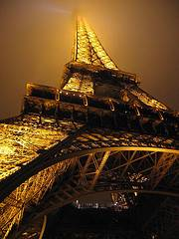
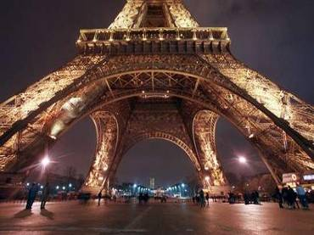
How does it work?
www.smh.com.au
Eiffel Tower at night by rednuht,
http://www.flickr.com/photos/rednuht/275062341/,
Creative Commons Attribution 2.0
http://creativecommons.org/licenses/by/2.0/deed.en
AUSTRALIA
part of the Creative Commons international initiative
CRICOS No. 00213J

Slide 21
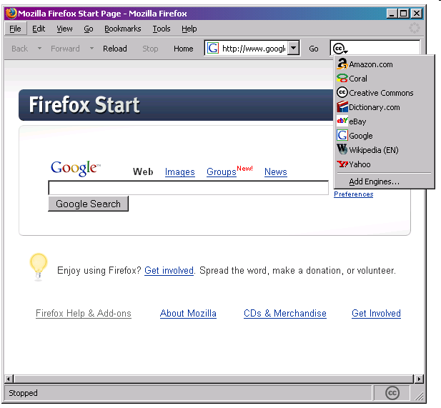
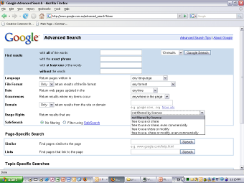
Finding CC material
Built in metadata makes CC materials easy to find.
Search engines with dedicated CC functions include Google, Yahoo, Flickr and Firefox (Linux web browser).
Creative Commons homepage lets you search by type of material.
AUSTRALIA
part of the Creative Commons international initiative
CRICOS No. 00213J
Notes:
But how do you find all of this material?
One of the most important innovations of the CC licensing model was to make the licences machine readable.
This means that, if the XHTML text is correctly embedded in the work, the work can be searched for through a series of specific CC search engines
this is probably one of the biggest benefits of using CC licensing – it makes it easy for those looking for material they can use to find your material, and gives you direct access to the open source and re-mix communities
Google, Yahoo, flickr and blip.tv all provide specific CC search tools, as does the firefox web browser

Slide 22








Finding CC material
AUSTRALIA
part of the Creative Commons international initiative
CRICOS No. 00213J

Slide 23
Before using CC material
Check that you’re following the licence (ask for extra permission if you need it)‏
Make sure your use isn’t ‘derogatory’
Are there any other rights you need?
Don’t forget to attribute
Use common sense
AUSTRALIA
part of the Creative Commons international initiative
CRICOS No. 00213J

Slide 24

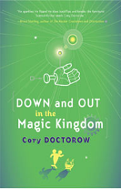
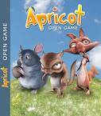

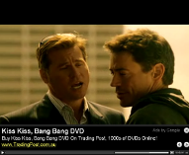

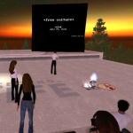


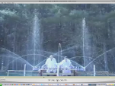

CC as a licensing tool
Facilitate sharing
Community engagement
Increase reach and reputation
Internal rights management
Access new business models
Encourage collaboration and innovation
AUSTRALIA
part of the Creative Commons international initiative
CRICOS No. 00213J
Notes:
In writing the licences, the main goal was to ensure that the licences are:
Voluntary – contrary to some claims, CC isn’t anti-copyright. It just aims to provide options for those copyright owners who do want to make their material more freely available
Flexible – unlike other parts of the open access movement, CC licences are specifically designed to provide a range of options for licensors, so that they can choose exactly how they want their material to be used
Easy to understand – the academics designing the licences felt that one of the biggest problems with default copyright law is that its so hard for both copyright owners and users to understand. So the licences are specifically designed to be as simple as possible.
And, of course, freely available for everyone to use

Slide 25
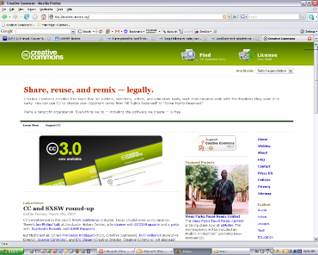
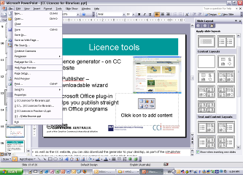
Choosing a licence
Licence generator – on CC website – uses simple questions to determine appropriate licence
Also available:
  ccPublisher – downloadable desktop wizard
  Microsoft plug-in –allows you to CC license straight from Office programs
  Individual site generators eg Flickr
AUSTRALIA
part of the Creative Commons international initiative
CRICOS No. 00213J
Notes:
As well as the CC website, you can also download the generator to your desktop, as part of the ccPublisher
This helps you automatically label your material as CC, and publish it online
In an interesting development, Microsoft has also recently released an plugin that allows you to label any work created in an Office as CC.
A number of sites also let you licence your material as cc – including flickr, and blip.tv

Slide 26
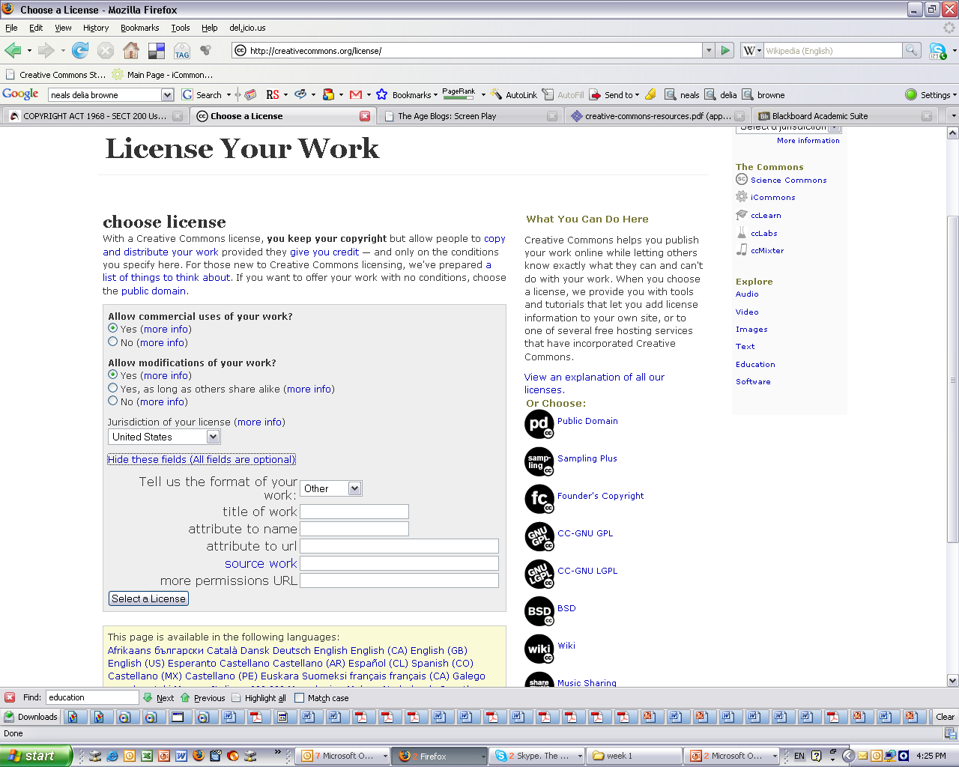
Licences
AUSTRALIA
part of the Creative Commons international initiative

Slide 27
Licences
AUSTRALIA
part of the Creative Commons international initiative
Notes:
Selecting a licence takes you through to a page that provides you with some XHTML text that you can copy onto you website
This basically ‘embeds’ the cc licence into your work, and displays the ‘licence button’ on your site
By clicking on the button, you’re taken through. . .

Slide 28

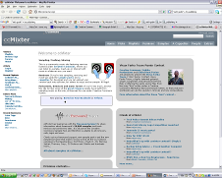


Doesn’t have to be all or nothing
You can apply CC to anything - short works, long works, previews/excerpts, samples, drafts, source material, back catalogue, ‘junk’
You can publish it anywhere – online, offline, own site, popular services, blogs, wikis, remix communities, businesses, peer-to-peer, bittorrent
AUSTRALIA
part of the Creative Commons international initiative
CRICOS No. 00213J

Slide 29
Before using CC licences
Who do you want to use the material, and when? eg global, perpetual
Are you choosing the right licence? eg do you want them to be able to change your material?
Do you have the rights to license the material? are you using anyone else’s material?
AUSTRALIA
part of the Creative Commons international initiative
CRICOS No. 00213J

Slide 30
Thanks
creativecommons.org
wiki.creativecommons.org/casestudies
creativecommons.org.au
info@creativecommons.org.au
Carpeted commons by Glutnix, http://www.flickr.com/photos/glutnix/2079709803/in/pool-ccswagcontest07 available under a Creative Commons Attribution 2.0 licence, http://creativecommons.org/licenses/by/2.0/deed.en
This slide show is licensed under a Creative Commons Australia Attribution licence. For more information see http://creativecommons.org/licenses/by/2.5/au/.
AUSTRALIA
part of the Creative Commons international initiative
CRICOS No. 00213J

